Slide 1
MyLaundry
SLICA
1

Slide 2
Group Information :
Group No. : 36
Roll No. Name
101 Sirsolkar Abhishek Subhashbhai
105 Solanki Rohitkumar Manubhai
113 Thakkar Karan Dilipkumar
Internal Guide : Prof. Khyati Shah
External Guide : Mr. DilipBhai Thakkar
SLICA
2

Slide 3
Table of Contents :
SR. NO | CONTENTS
1 | My Laundry
2 | Group Information
3 | Company Profile
4 | Project Definition
5 | Process Description
6 | Existing System
7 | Limitation Of Existing System
8 | Proposed System
9 | Objectives of proposed system
10 | Development Tools and Technology used
11 | Inputs
12 | Outputs
SLICA
3

Slide 4
SR.NO | CONTENTS
13 | Entity Relationship Diagram
14 | UML Diagrams
 | 1.Use-Case Diagram
 | 2.Class Diagram
 | 3.Object Diagram
 | 4.Sequence Diagram
 | 5.Collaboration Diagram
 | 6.Activity Diagram
 | 7.State-Chart Diagram
15 | Data-Dictionary
16 | Bibliography
SLICA
4

Slide 5
Company Profile :
Company Name : Hashmukh Laundry Services
Address : Sir Lakhajiraj Road,
Sanganva Chowk,
Trikon Baag,
Rajkot-360007
Contact : 8849059151
SLICA
5

Slide 6
Project Definition :
MyLaundry will be website that helps customer to select packages(yearly , monthly) or service (e.g. Wash , iron and dry cleaning) and it will also provide pickup and delivery from customer home.
It will also help admin manage customer details , order details and keep records of customers , services and package online .
SLICA
6

Slide 7


Process Description :
1.Visit the Shop
Customer
5. Return Cloth
2(a).Select Package
2(b).Select Services
4.Laundry Process
6.Give Payment
3.Give an Order
7.Invoice
Owner
SLICA
7

Slide 8
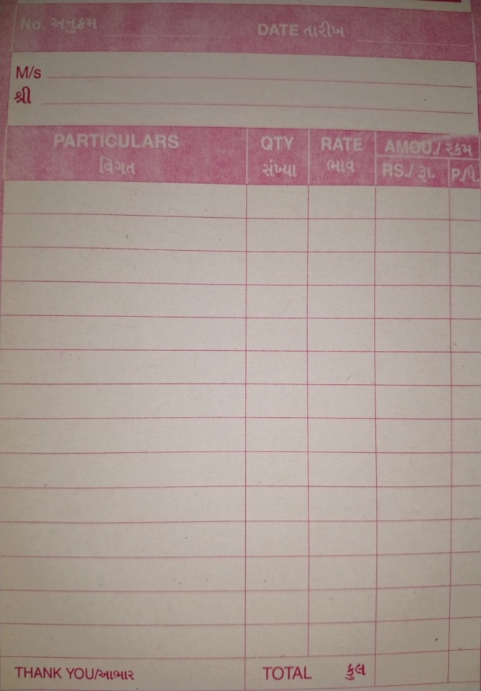

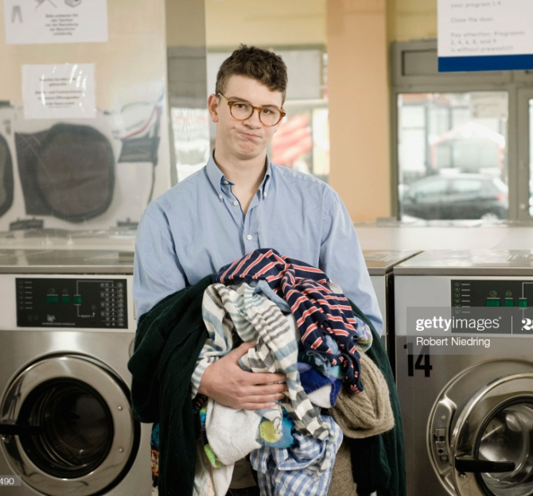
Existing System :
In the existing system all transaction & dealings of orders are done manually & Invoice is hand written.
SLICA
8

Slide 9
Limitations of Existing System :
Customers have to visit the shop to get the details for the order and it is time consuming.
Maintaining customer information is a tedious because of paper work.
No records are maintained for customer’s feedback & rating.
Customer can't check the status of their order.
SLICA
9

Slide 10
Report can’t be generated.
Customers have to visit the shop to get and give clothes, pay and get bills.
SLICA
10

Slide 11
Proposed System :
There are 4 main Actors:
Admin
Employee
Customer
Visitor
SLICA
11

Slide 12
Admin :
Login
Manage Profile
Manage Employee Details
Manage Customer Details
Manage Appointments
Manage Order Details
Manage Services Details
Manage Package(monthly , yearly)
Manage Offers & Discount
Manage Cloth’s type price list
Manage Complains & Queries
Generate Invoice
View Ratings & Feedback
Send Notification to Customer
Generate Reports
SLICA
12

Slide 13
Employee :
Login
Manage Profile
View Customer Details
View Appointment
Pick-Up Cloth From Customer Home
View Order Details
Manage Order Status
SLICA
13

Slide 14
Customer :
Login
Manage Profile
View and search package & services details
Select Packages & Services
Take Appointment
View Cloth type & Price List
View Offers & Discount
Manage Cart
Place Orders
View Order history
View Order Status
Give feedback & Rating
Get an e-Invoice
Send Complaints & Queries
Receive notification from Admin
SLICA
14

Slide 15
Visitor :
Registration As customer
View and search services & Packages
Send Inquiry
View Complain & Queries
View Rating & Feedback
SLICA
15

Slide 16
Objectives of Proposed System :
Customer can see and give orders from any place any time using internet.
Admin can easily maintain all the detail of customer and order.
Customer can select individuals services and packages as per their requirements.
SLICA
16

Slide 17
Feedbacks and ratings given by customers can be easily recorded.
Provide more reach and ease of management to the Laundry.
Reports can be easily generated.
SLICA
17

Slide 18
Development Tools and Technology used :
Hardware:
Processor | Intel Core i3
RAM | 4 GB
Hard Disk | 1 TB
SLICA
18

Slide 19
Software:
Front End | ASP.NET
Operating System | Windows 10
IDE | Microsoft Visual Studio 2010
Back End | SQL Server 2008
Framework | .Net Framework 4.0
Web Server | IIS
Presentation Tool | Microsoft PowerPoint 2016
Diagram Tool | Visual Paradigm 8.0
Programming Language | C#
SLICA
19

Slide 20
Inputs :
Customer Details
Employee Details
Service Details
Appointment Details
Order Details
Cloth type & Price List
Package Details
Delivery Details
Feedback & Rating
Complain & Queries
SLICA
20

Slide 21
Outputs :
Customer detail (Area Wise)
Employee detail
Order Report
Appointment Report (daily , weekly)
Cloth type price list Report
Package detail
Invoice
Delivery Report
SLICA
21

Slide 22
Entity Relationship Diagram :-
SLICA
22

Slide 23
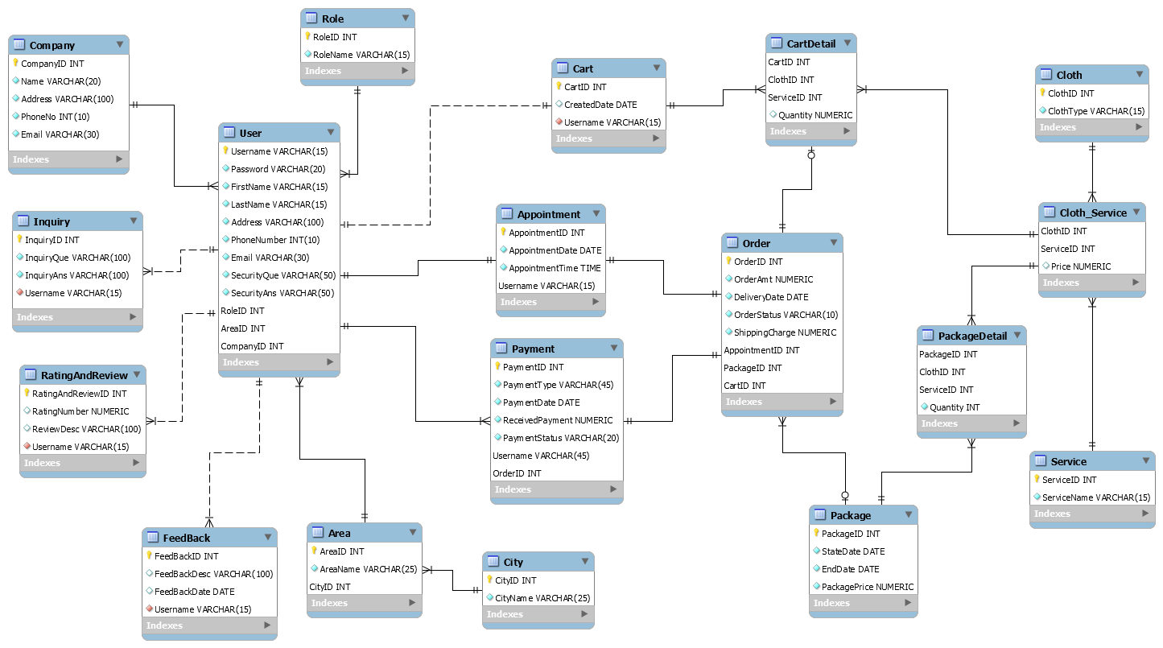
SLICA
23

Slide 24
UML Diagrams UseCase
SLICA
24

Slide 25
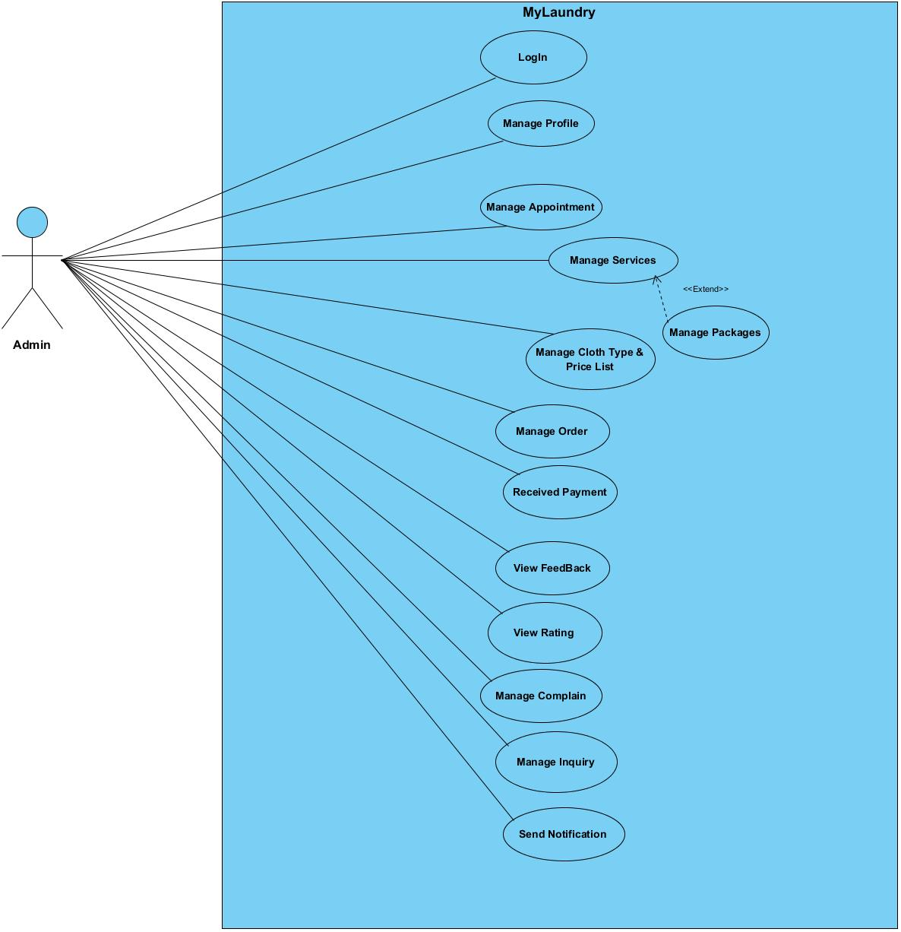
Admin :-
SLICA
25

Slide 26
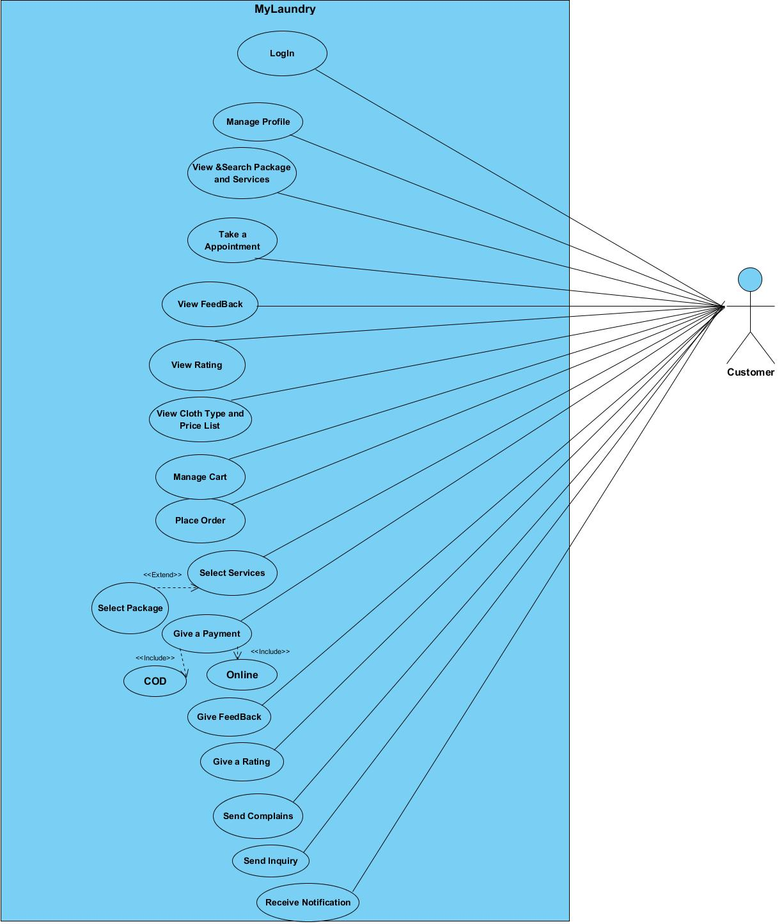
Customer :-
SLICA
26

Slide 27
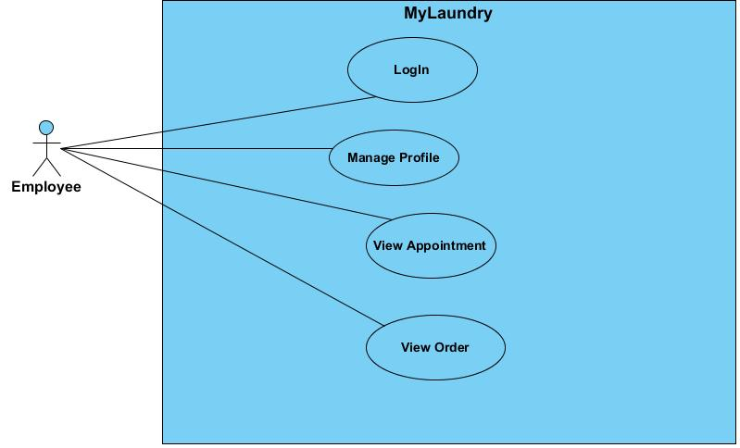
Employee :-
SLICA
27

Slide 28
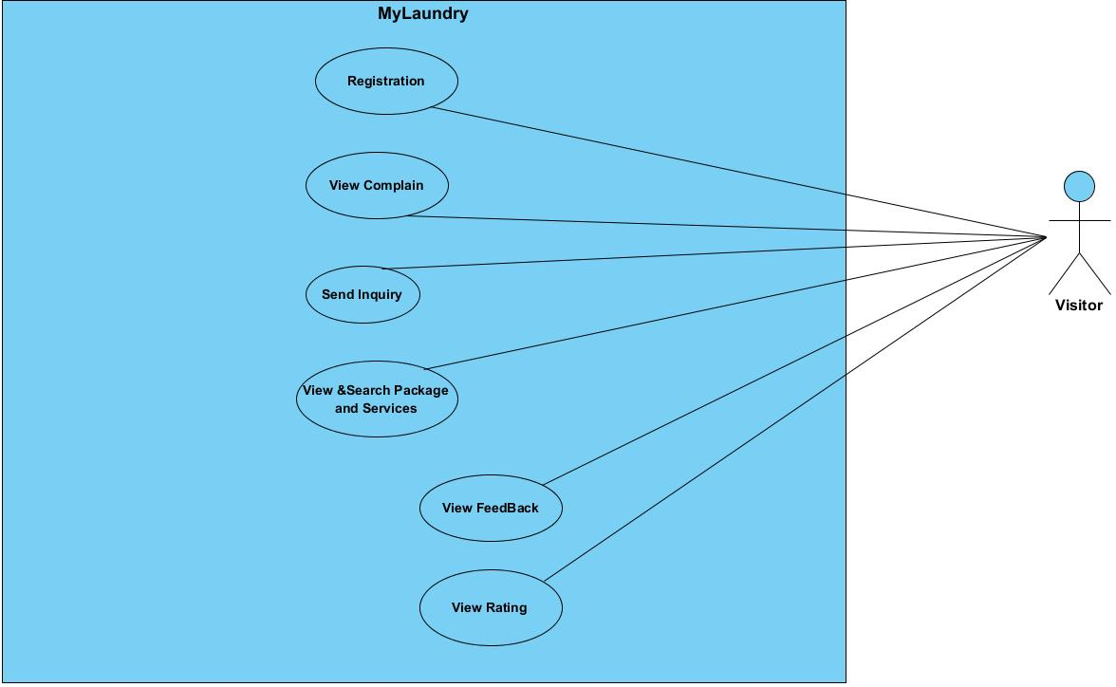
Visitor :-
SLICA
28

Slide 29
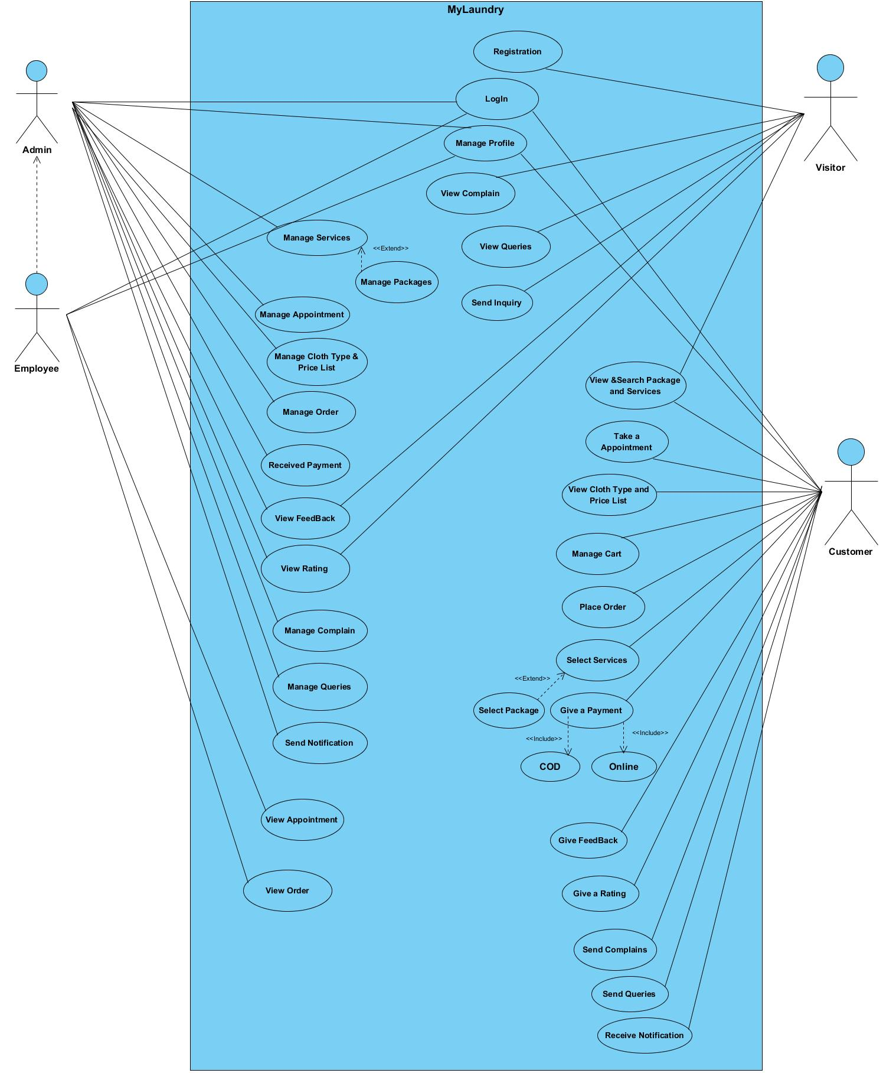
MyLaundry :-
SLICA
29

Slide 30
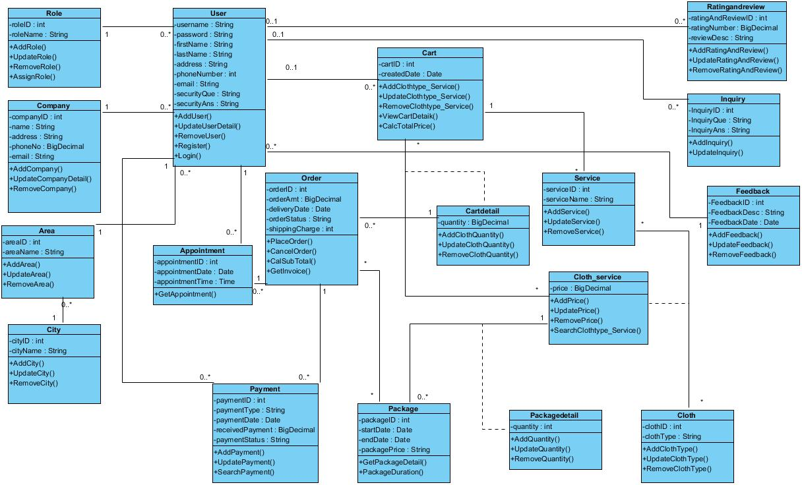
Class Diagram :-
SLICA
30

Slide 31
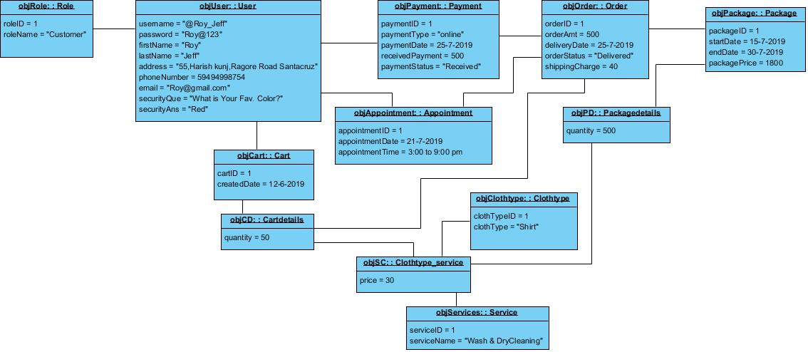
Object Diagram :-
SLICA
31

Slide 32
Sequence Diagrams :-
SLICA
32

Slide 33
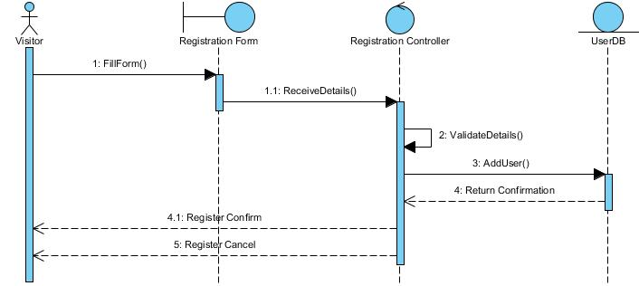
Registration :-
SLICA
33

Slide 34
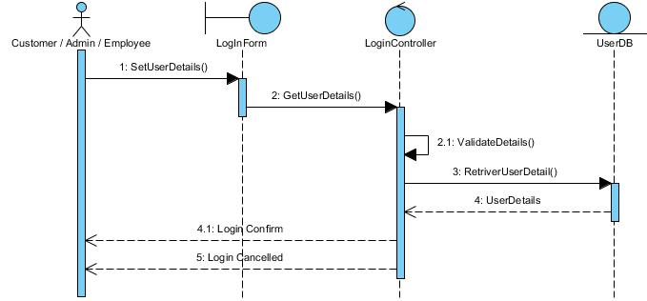
LogIn :-
SLICA
34

Slide 35
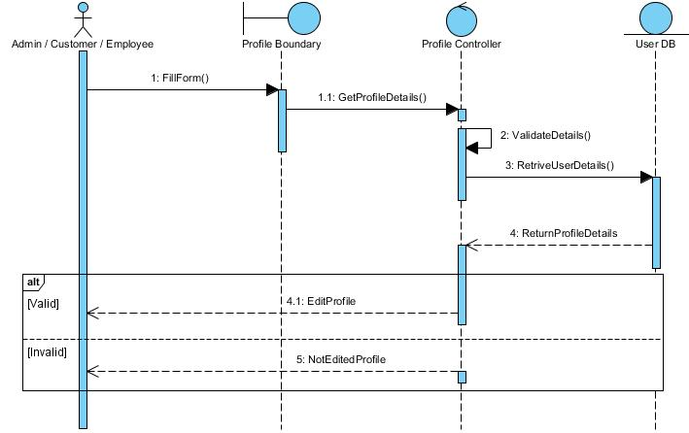
Manage Profile :-
SLICA
35

Slide 36
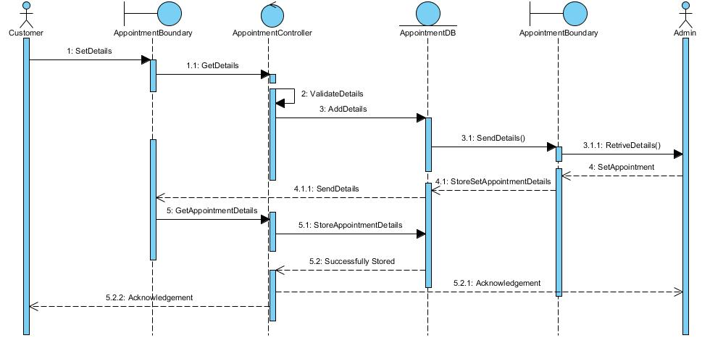
Appointment :-
SLICA
36

Slide 37
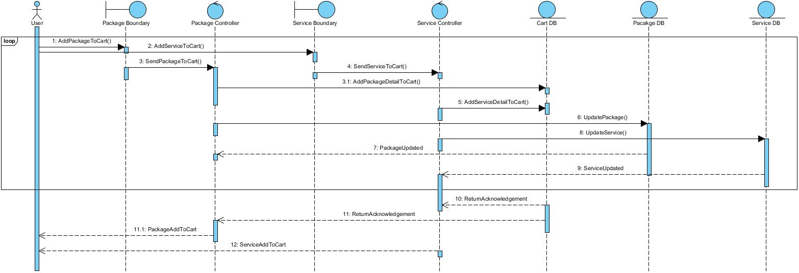
Manage Cart :-
SLICA
37

Slide 38
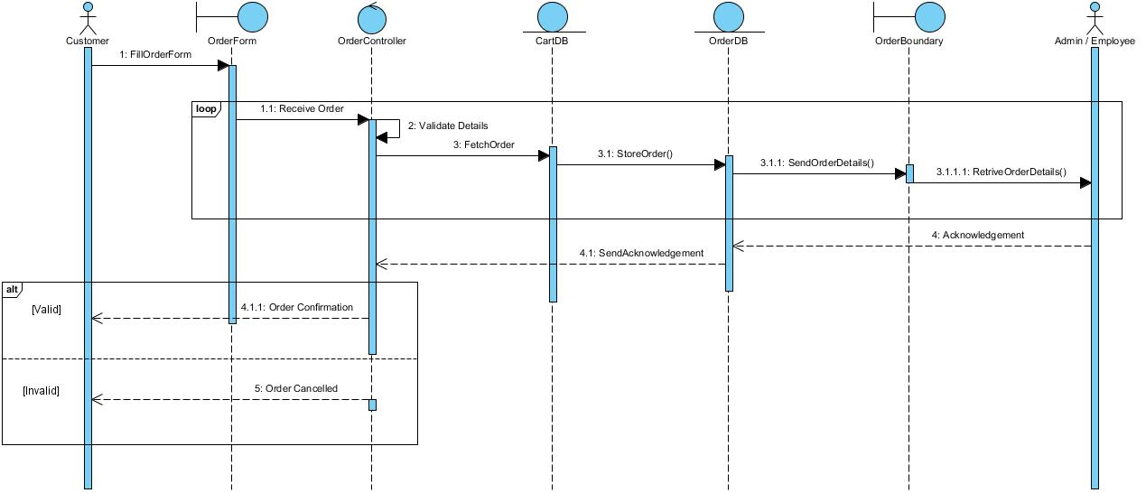
Place Order :-
SLICA
38

Slide 39
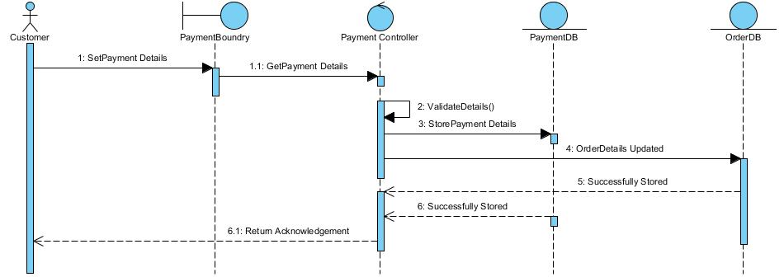
Payment :-
SLICA
39

Slide 40
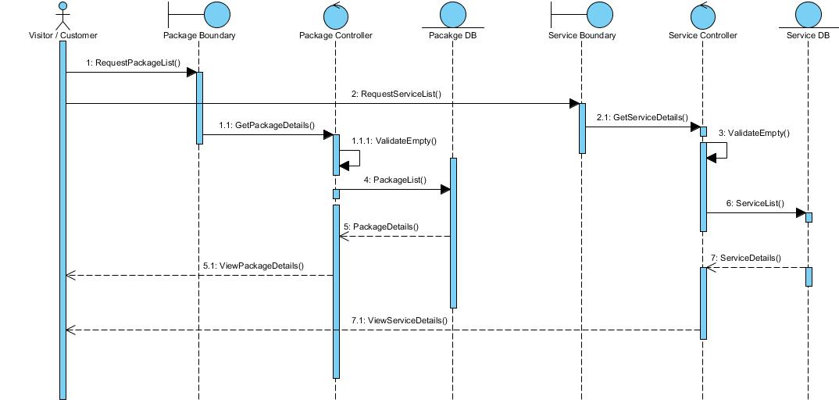
View & Search Package and Services :-
SLICA
40

Slide 41
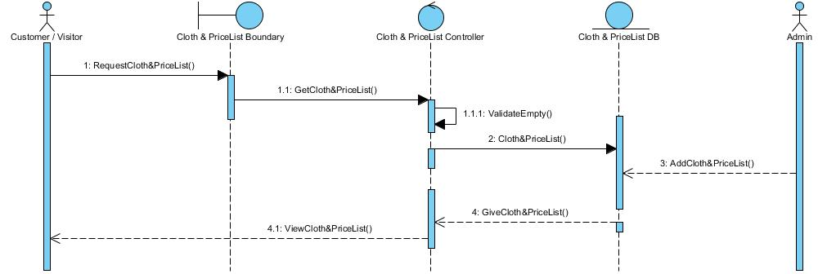
View Cloth & PriceList:-
SLICA
41

Slide 42
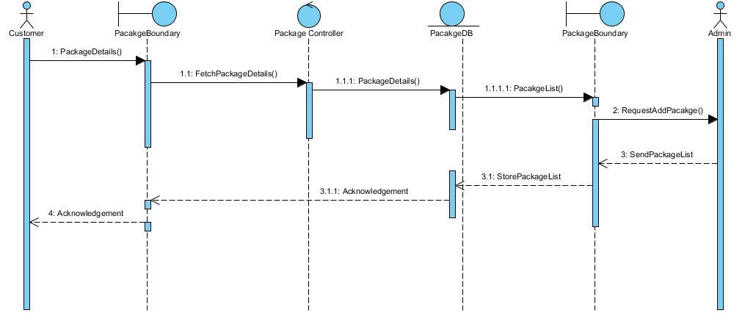
Select & Manage Packages :-
SLICA
42

Slide 43
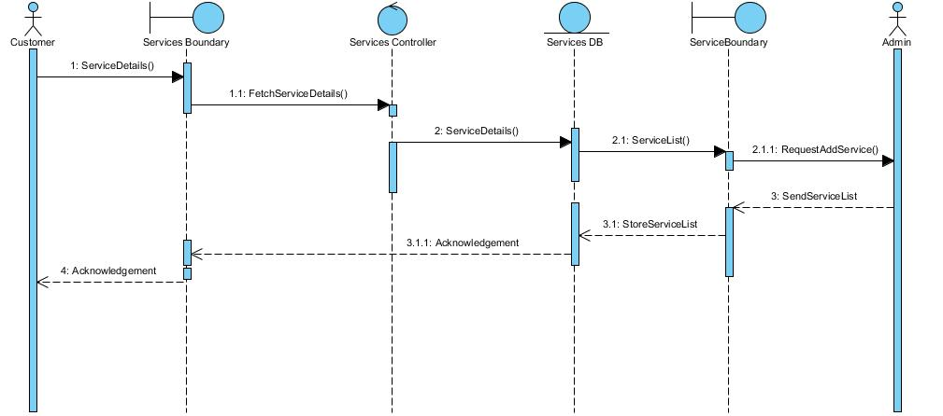
Select & Manage Services :-
SLICA
43

Slide 44
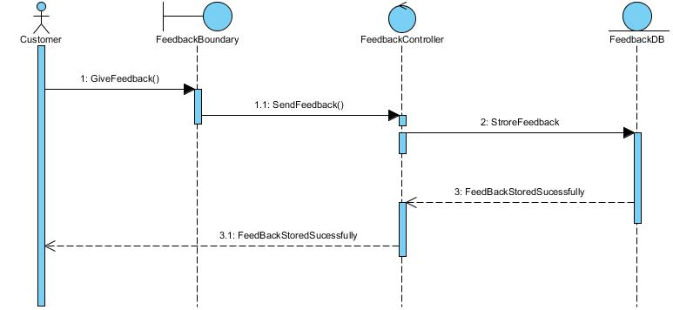
Feedback :-
SLICA
44

Slide 45
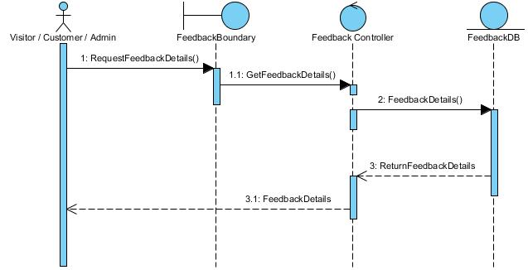
View Feedback :-
SLICA
45

Slide 46
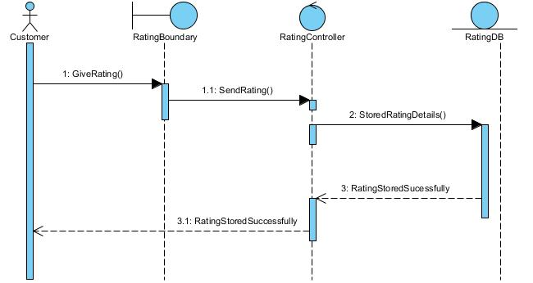
Rating:-
SLICA
46

Slide 47
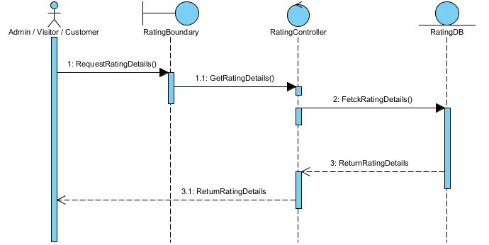
View Rating :-
SLICA
47

Slide 48
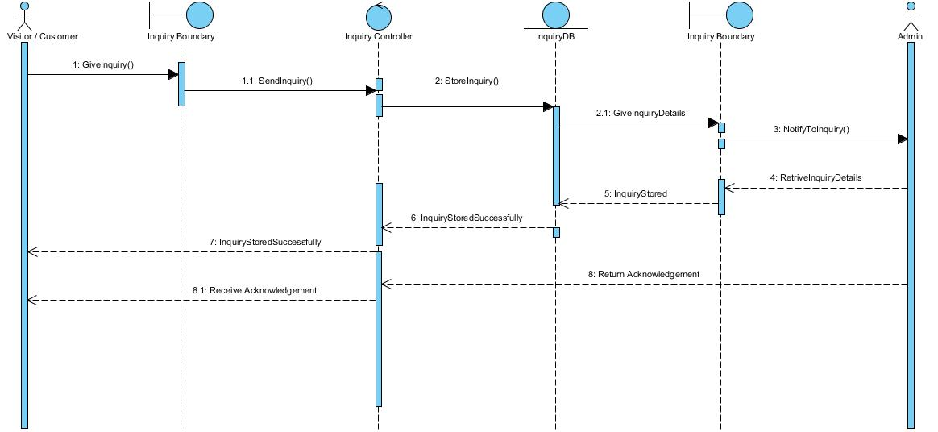
Inquiry :-
SLICA
48

Slide 49
Collaboration Diagrams :-
SLICA
49

Slide 50
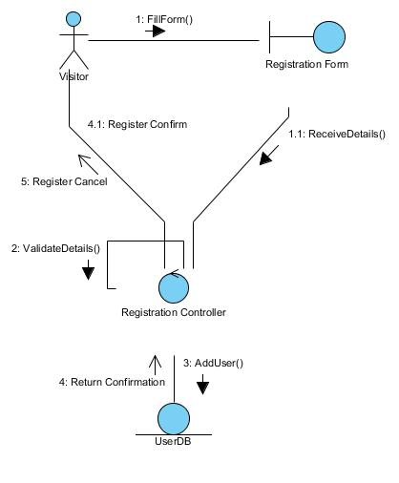
Registration :-
SLICA
50

Slide 51
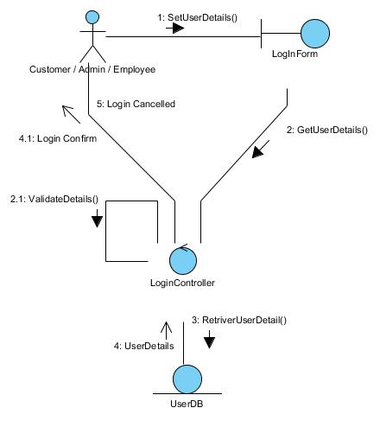
LogIn :-
SLICA
51

Slide 52
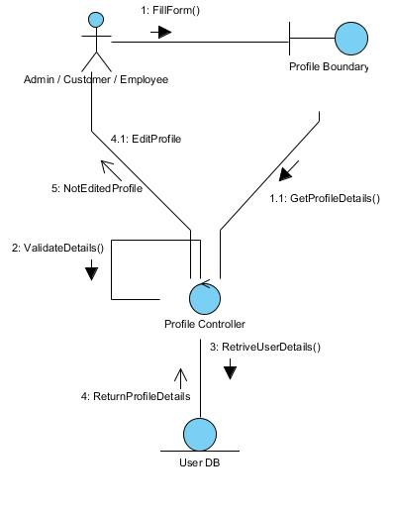
Manage Profile :-
SLICA
52

Slide 53
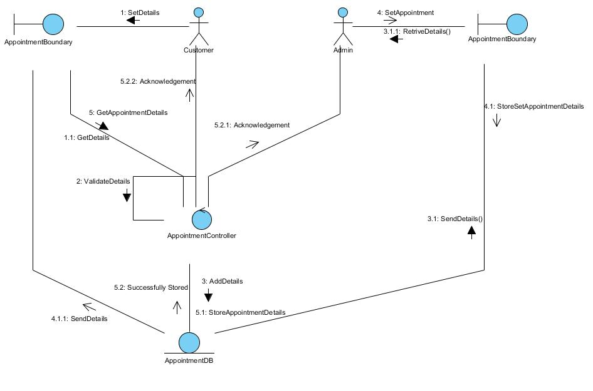
Appointment :-
SLICA
53

Slide 54
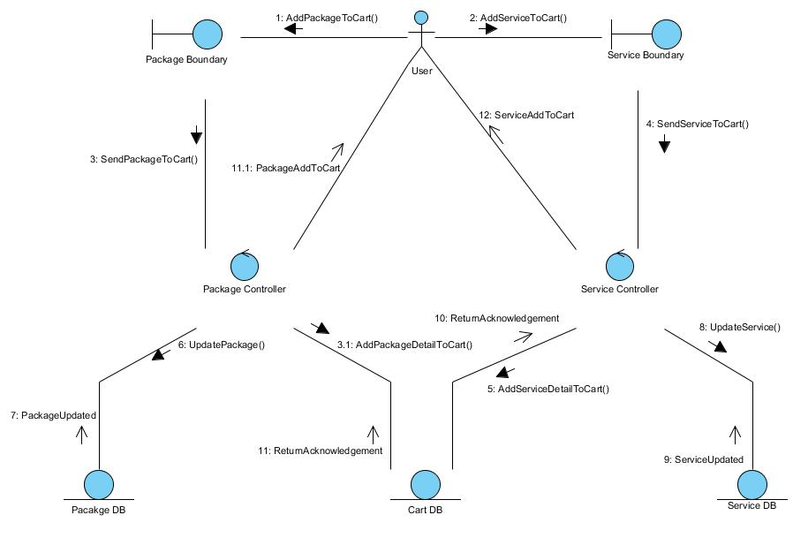
Manage Cart :-
SLICA
54

Slide 55
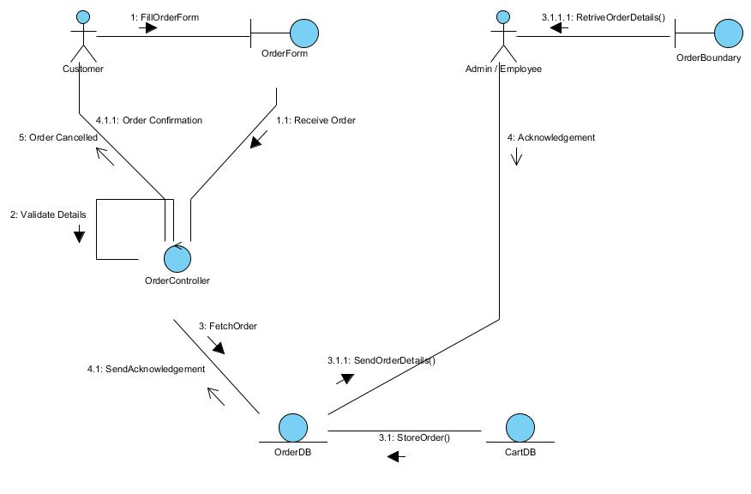
Place Order :-
SLICA
55

Slide 56
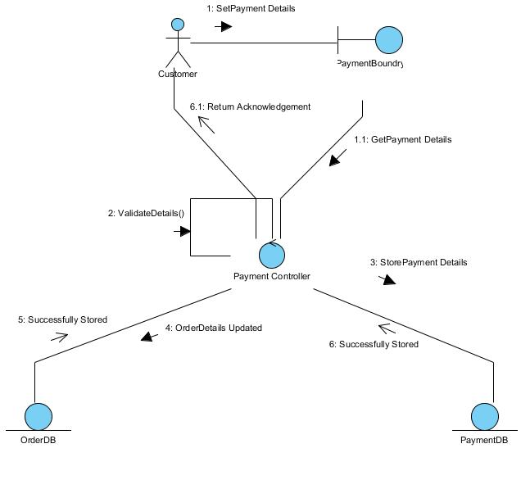
Payment :-
SLICA
56

Slide 57
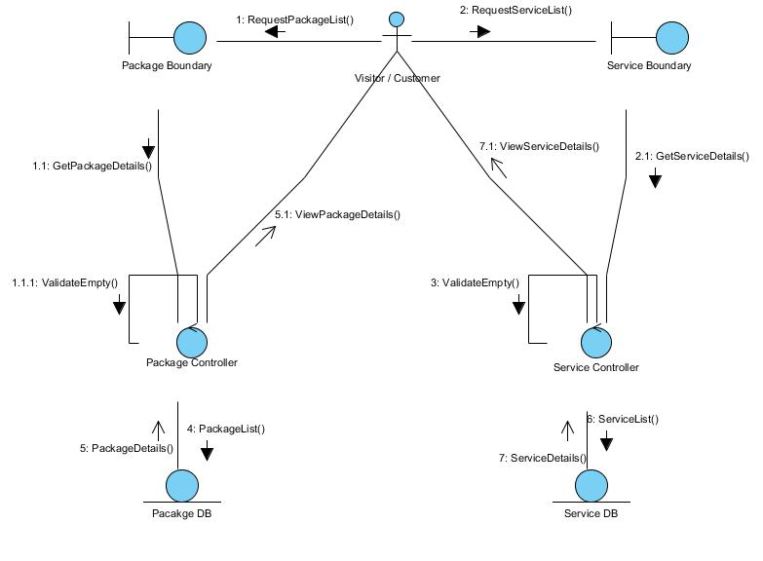
View & Search Package and Services :-
SLICA
57

Slide 58
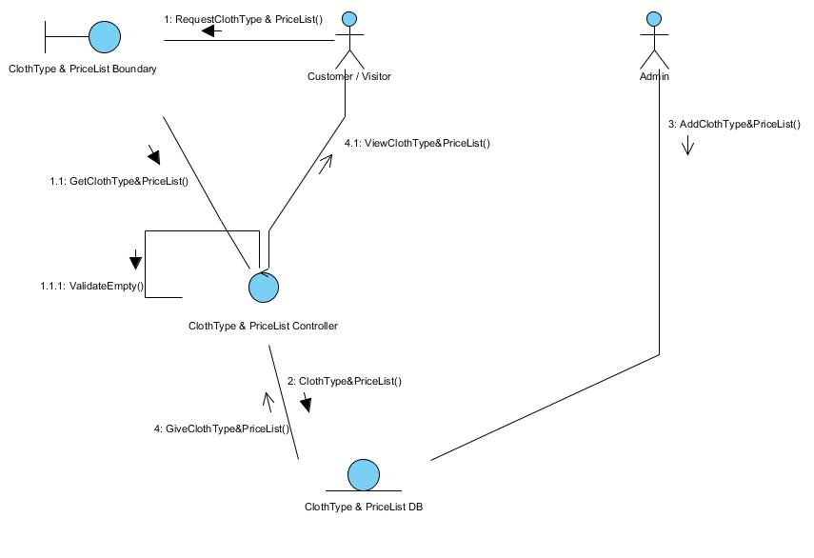
View Cloth & PriceList:-
SLICA
58

Slide 59
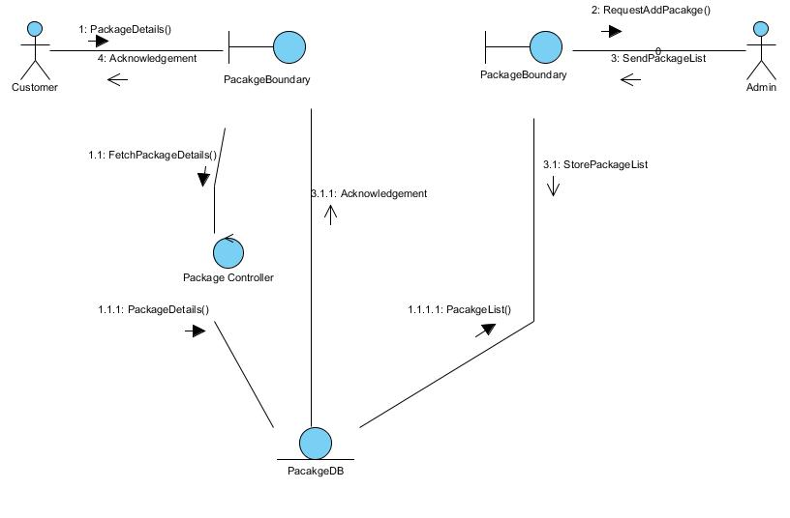
Select & Manage Packages :-
SLICA
59

Slide 60
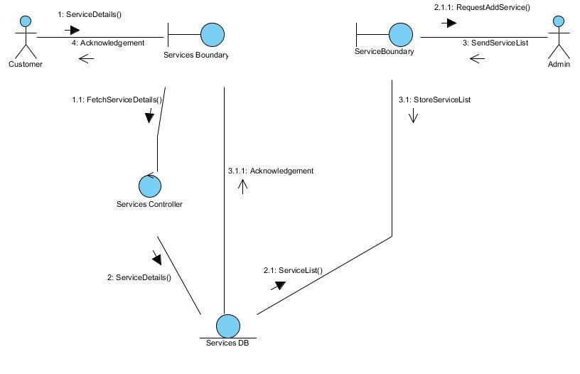
Select & Manage Services :-
SLICA
60

Slide 61
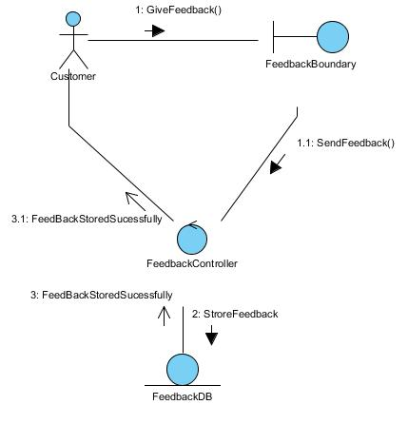
FeedBack :-
SLICA
61

Slide 62
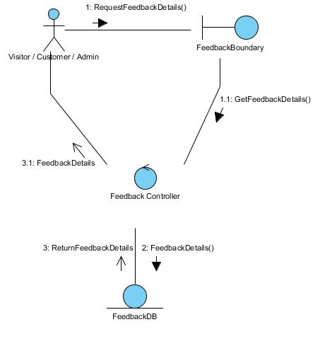
View FeedBack :-
SLICA
62

Slide 63
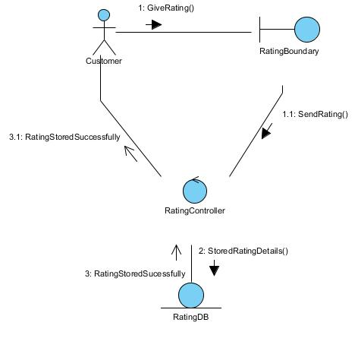
Rating:-
SLICA
63

Slide 64
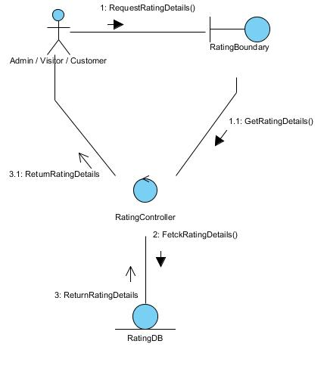
View Rating :-
SLICA
64

Slide 65
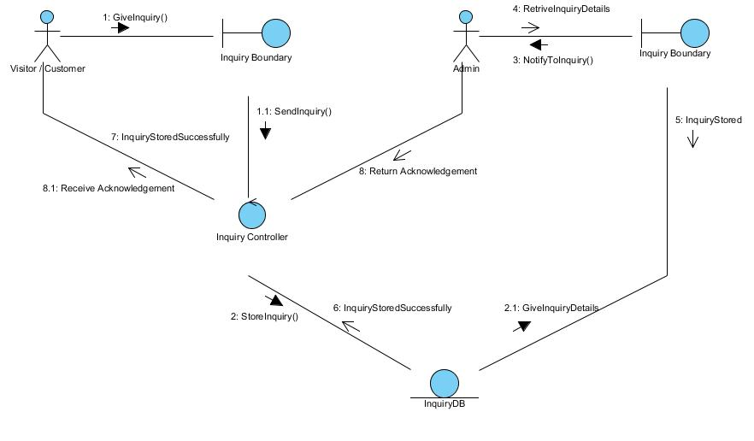
Inquiry :-
SLICA
65

Slide 66
Activity Diagram :-
SLICA
66

Slide 67
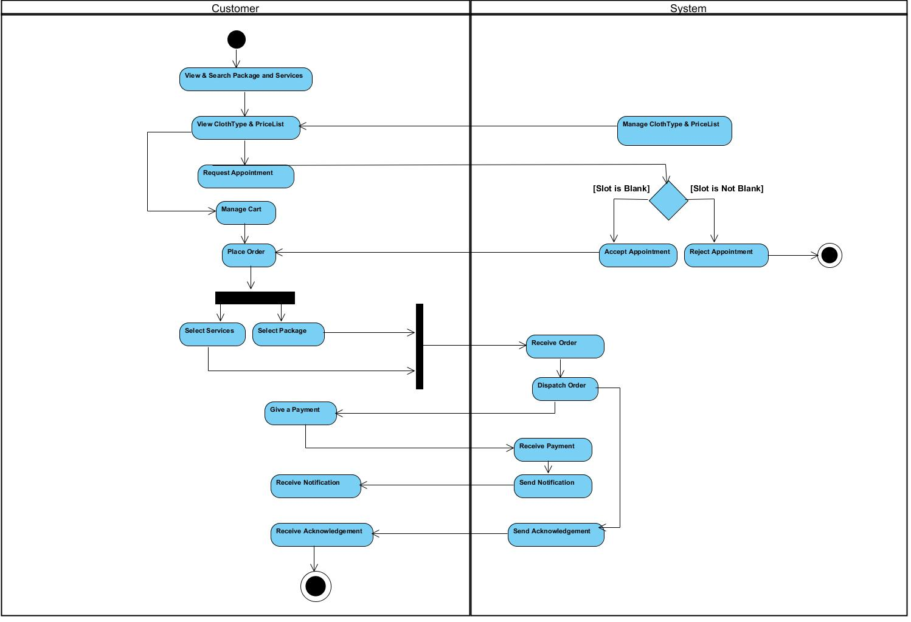
SLICA
67

Slide 68
State Chart Diagram :-
SLICA
68

Slide 69
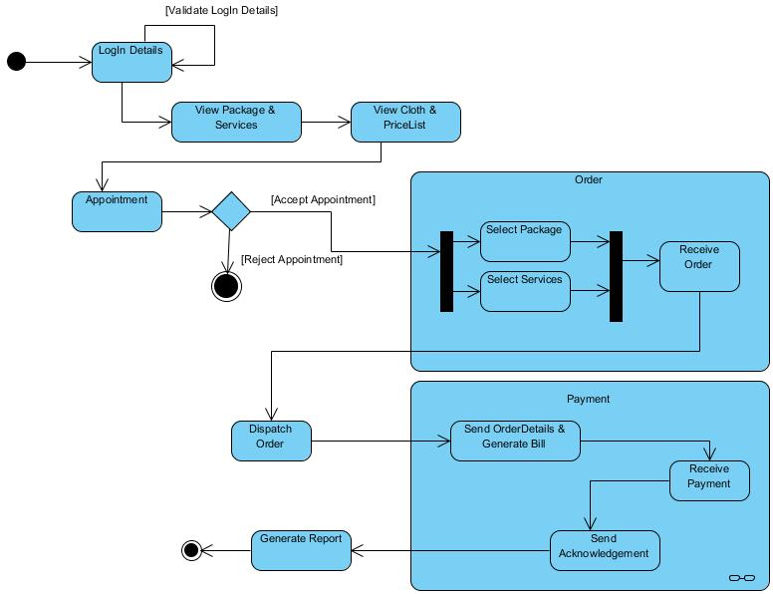
SLICA
69

Slide 70
Data Dictionary
Role : - This table will store details of Role.
Company :- This table will store details of Company.
Field Name | Data Type | Constraints | Description
RoleID | Integer | Primary Key | Id of Role
RoleName | Varchar(15) | Not Null | Name of Role
Field Name | Data Type | Constraints | Description
CompanyID | Integer | Primary Key | Id of Company
Name | Varchar(15) | Not Null | Name of Company
Address | Varchar(100) | Not Null | Company Address
PhoneNo | Numeric(13) | Not Null | Company Phone Number
Email | Varchar(25) | Not Null | Email Address
SLICA
70

Slide 71
City :- This table will store details of City.
Field Name | Data Type | Constraints | Description
CityID | Integer | Primary key | Id of City
CityName | Varchar(15) | Not Null | Name of City
Area :- This table will store details of Area.
Field Name | Data Type | Constraints | Description
AreaID | Integer | Primary key | ID of Area
AreaName | Varchar(15) | Not Null | Name of Area
CityID | Integer | Foreign key | ID of City
SLICA
71

Slide 72
User :- This table will store details of User.
Field Name | Data Type | Constraints | Description
UserName | Varchar(15) | Primary key | Login Username
Password | Varchar(20) | Not Null | Login Password
FirstName | Varchar(15) | Not Null | User’s First Name
LastName | Varchar(15) | Not Null | User’s Last Name
Address | Varchar(100) | Not Null | User’s Address
PhoneNumber | Numeric(13) | Not Null | User’s Phone Number
Email | Varchar(25) | Not Null | Email Address
SecurityQue | Varchar(100) | Not Null | Security Question
SecurityAns | Varchar(100) | Not Null | Security Answer
RoleID | Integer | Foreign key | ID of Role
CompanyID | Integer | Foreign key | ID of Company
AreaID | Integer | Foreign key | ID of Area
SLICA
72

Slide 73
Cloth :- This table will store details of Cloth.
Field Name | Data Type | Constraints | Description
ClothID | Integer | Primary Key | Id of Cloth
Cloth | Varchar(15) | Not Null | Type of Cloth
Service :- This table will store details of Services.
Field Name | Data Type | Constraints | Description
ServiceID | Integer | Primary key | Id of Service
Servicename | Varchar(15) | Not Null | Name of Service
SLICA
73

Slide 74
Cloth_Service :- This table will store details of Cloth and Service(Bridge Table).
Field Name | Data Type | Constraints | Description
ClothID | Integer | Primary Key + Foreign key | Id of Cloth
ServiceID | Integer | Primary Key + Foreign key | Id of Service
Price | Numeric | Not Null | Price
Package :- This table will store details of Package.
Field Name | Data Type | Constraints | Description
PackageID | Integer | Primary key | ID of Package
StartDate | Date | Not Null | Package Start Date
EndDate | Date | Not Null | Package End Date
PackagePrice | Numeric | Not Null | Price of Package
SLICA
74

Slide 75
Cart :- This table will store details of Cart.
CartDetails :- This table will store details of Cart and Cloth_Service (Bridge Table).
Field Name | Data Type | Constraints | Description
CartID | Integer | Primary Key | Id of Cart
CreatedDate | Date | Not Null | Cart Created Date
Username | Varchar(15) | Foreign Key | Reference of User
Field Name | Data Type | Constraints | Description
CartID | Integer | Primary Key + Foreign Key | Id of Cart
ClothID | Integer | Primary Key + Foreign Key | Id of ClothType
ServiceID | Integer | Primary Key + Foreign Key | Id of Service
Quantity | Numeric | Not Null | Quantity
SLICA
75

Slide 76
PackageDetails :- This table will store details of Package and Cloth_Service (Bridge Table).
Field Name | Data Type | Constraints | Description
PackageID | Integer | Primary key + Foreign key | Id of Package
ClothID | Integer | Primary key + Foreign key | Id of ClothType
ServiceID | Integer | Primary key + Foreign key | Id of Service
Quantity | Numeric | Not Null | Quantity of Order
Appointment :- This table will store details of Appointment.
Field Name | Data Type | Constraints | Description
AppointmentID | Integer | Primary Key | Id of Appointment
AppointmentDate | Date | Not Null | AppointmentDate
AppointmentTime | Time | Not Null | AppointmentTime
Username | Varchar(15) | Foreign key | Reference of User
SLICA
76

Slide 77
Order :- This table will store details of Order.
Field Name | Data Type | Constraints | Description
OrderID | Integer | Primary Key | Id of Order
OrderAmt | Numeric | Not Null | Amount Ordered
DeliveryDate | Date | Not Null | Date of Delivery
OrderStatus | Varchar(10) | Not Null | Status of Order
ShippingCharge | Numeric | Not Null | Charge of Shipping
AppointmentID | Integer | Foreign key | Id of Appointment
PackageID | Integer | Foreign key | Id of Package
CartID | Integer | Foreign key | Id of Cart
SLICA
77

Slide 78
Inquiry :- This table will store details of Inquiry.
Field Name | Data Type | Constraints | Description
InquiryID | Integer | Primary Key | Id of Inquiry
InquiryQue | Varchar(100) | Not Null | Inquiry Question
InquiryAns | Varchar(100) | Not Null | Answer for Inquiry
Username | Varchar(15) | Foreign key | Reference of User
Payment :- This table will store details of Payment.
Field Name | Data Type | Constraints | Description
PaymentID | Integer | Primary key | Id of Payment
PaymentType | Varchar(15) | Not Null | Type of Payment
PaymentDate | Date | Not Null | Date of Paying
RecievedPayment | Numeric | Not Null | Amount Paid
PaymentStatus | Varchar(20) | Not Null | Status of Payment
Username | Varchar(15) | Foreign key | Reference of User
CartID | Integer | Foreign key | Id of Cart
SLICA
78

Slide 79
RatingAndReview :- This table will store details of Rating And Review.
Feedback :- This table will store details of Feedback.
Field Name | Data Type | Constraints | Description
RatingAndReviewID | Integer | Primary key | Id of Rating and Review
RatingNumber | Numeric | Not Null | Number of Rating
ReviewDesc | Varchar(100) | Not Null | Review Description
Username | Varchar | Foreign key | Reference of User
Field Name | Data Type | Constraints | Description
FeedbackID | Integer | Primary key | Id of Feedback
FeedBackDesc | Varchar(100) | Not Null | Feedback Description
FeedBackDate | Date | Not Null | Date of Feedback
SLICA
79

Slide 80
Bibliography :-
Reference Books :
Object Oriented Analysis And Design
Database System Concepts
Database Management System-II
Reference Website :
https://www.mssqltips.com
https://stackoverflow.com
https://w3schools.com
SLICA
80

Slide 81
Thank You
SLICA

